Slide 1
Machine Learning in Production
Dr. Bhaskar Chakraborty

Slide 2
About me
Background
Machine Learning and Artificial Intelligence research, S/W engineering and Architecture
PhD in Computer Vision
Now
AI Architect/ML Engineer @UniCredit AI team
Building end-to-end AI applications for banking workflows
LinkedIn, Github

Slide 3
Content
Introduction to ML in production
Catch points → ML in production
ML Serving
ML model drift
MLOps - the backbone of ML applications in production
ML app lifecycle
Compliance
Demo
Q&A and Discussion

Slide 4
Quick recap: what is ML?

Slide 5
Quick recap: what is ML?
→
→
𝑿 🠖 𝐲
Symbolic representation of Input data vector transforming into a meaningful output data vector

Slide 6

Quick recap: what is ML?
→
→
𝑿 🠖 𝐲
ML techniques

Slide 7
Quick recap: what is ML?
→
→
𝑿 🠖 𝐲
ML techniques
→
ML teaches us different tools and techniques to transform an input vector 𝑿 to a meaningful output vector 𝐲
→

Slide 8
Examples of (X, y)
Input: Transactional details (amount, location, time and user history)
Output: Fraud / Not fraud
Use-case: Fraud detection in Banking

Slide 9
Examples of (X, y)
Input: Email text, sender info, metadata
Output: Spam / Not Spam
Use-case: Spam email filtering

Slide 10
Examples of (X, y)
Input: Camera images, Censor data (LiDAR), GPS signal
Output: Steering angle, acceleration and braking command
Use-case: Autonomous driving

Slide 11
Examples of (X, y)
Input: Patient data (symptoms, lap results, scanned images)
Output: Disease prediction, diagnosis report
Use-case: Medical diagnosis

Slide 12

ML in production: ML phase
Business use-case

Slide 13
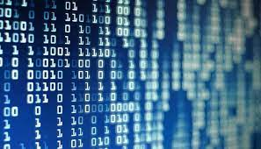
ML in production: ML phase
Business use-case
Data (𝑿)

Slide 14
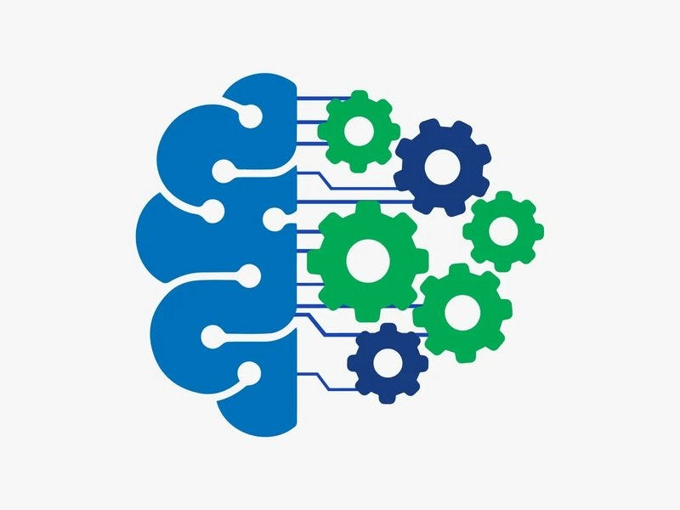
ML in production: ML phase
Business use-case
Data (𝑿)
ML Model (𝑿 →𝐲)

Slide 15
ML in production: ML phase
Business use-case
Data (𝑿)
ML Model (𝑿 →𝐲)
ML

Slide 16
ML in production: Production phase
ML Model (𝑿 →𝐲)

Slide 17

ML in production: Production phase
ML Model (𝑿 →𝐲)
Deployment

Slide 18

ML in production: Production phase
𝑿
ML Model (𝑿 →𝐲)
Deployment

Slide 19
ML in production: Production phase
𝑿
𝐲
ML Model (𝑿 →𝐲)
Deployment
Production

Slide 20
ML in production
𝑿
𝐲
Business use-case
Data (𝑿)
ML Model (𝑿 →𝐲)
Deployment
ML
Production

Slide 21
Catch point: Deployment
𝑿
𝐲
Business use-case
Data (𝑿)
ML Model (𝑿 →𝐲)
Deployment
What is deployment and how does it work?
How to ensure a reliable deployment?
How to make the ML model available to the users?

Slide 22
Catch point: Model drift
𝑿
𝐲
Business use-case
Data (𝑿)
ML Model (𝑿 →𝐲)
Deployment
The data distribution in Production often varies from the data distribution used for the initial model training → Model drift
How to identify the model drift?
How to properly address this model drift?

Slide 23
ML Model to the user
What is inside the ML model?

Slide 24
ML Model to the user
What is inside the ML model?
A set of real numbers representing parameters and hyper-parameters of several hyperplanes
Usually this parameter set is very large

Slide 25
ML Model to the user
What is inside the ML model?
A set of real numbers representing parameters and hyper-parameters of several hyperplanes
Usually this parameter set is very large
We also need a set of libraries that can read those parameters and can give the prediction

Slide 26
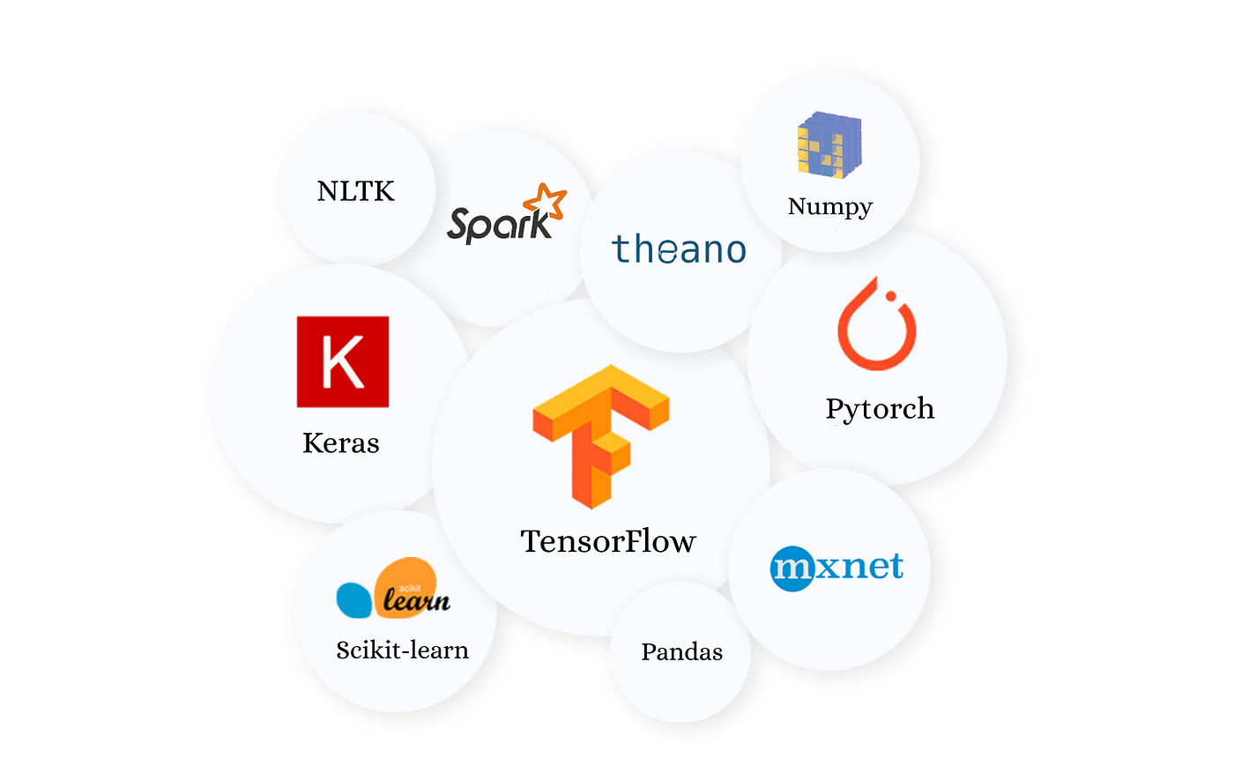
ML Model to the user
What is inside the ML model?
A set of real numbers representing parameters and hyper-parameters of several hyperplanes
Usually this parameter set is very large
We also need a set of libraries that can read those parameters and can give the prediction

Slide 27
ML Model to the user
To make available the ML model we need
An interface that two computer systems use to exchange information securely over the Internet

Slide 28
ML Model to the user
To make available the ML model we need
An interface that two computer systems use to exchange information securely over the Internet
If such an interface exists, we can put our ML model in one computer and all the users will communicate to that computer to send the input data X to get the prediction y

Slide 29
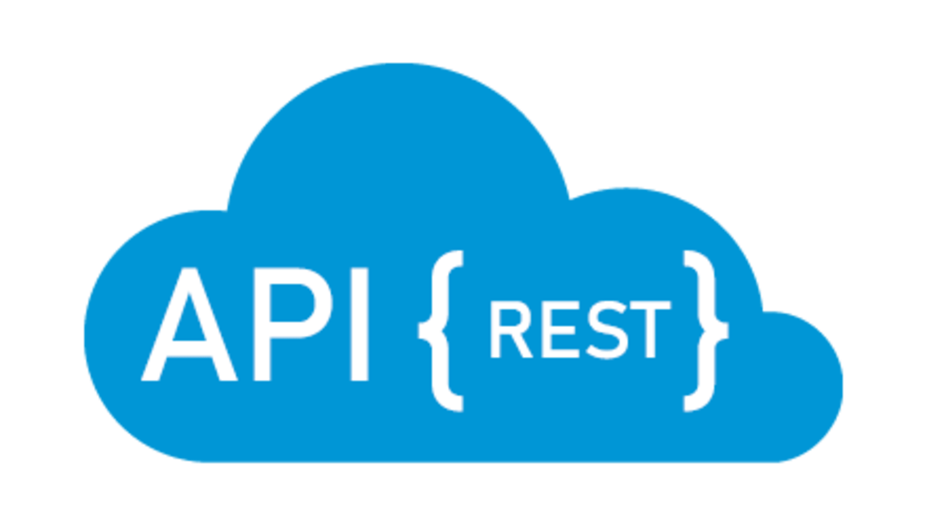
ML Model to the user
Thanks to the RESTful API, we are wrap the Ml model to make available to the users
ML serving

Slide 30
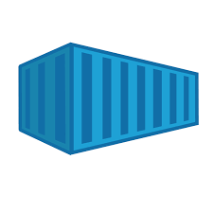
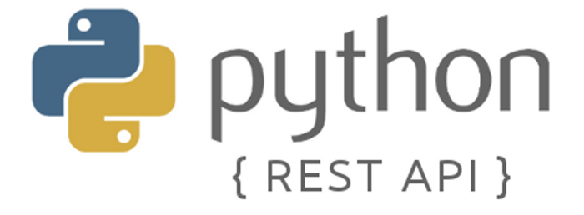
Code Container Container Orchestrator
ML code container
We containerize the code –> a lightweight, standalone, executable package of software that bundles an application's code with all its dependencies, like libraries and configuration files.

Slide 31

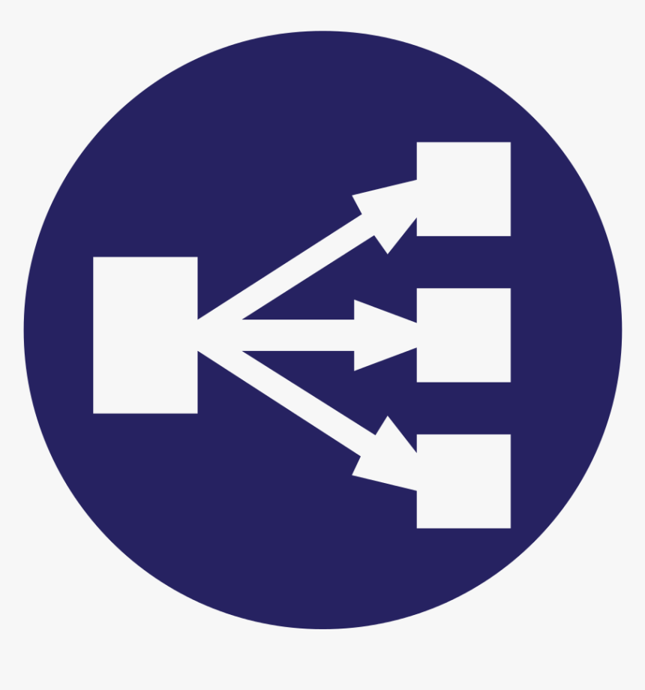
Code Container Container Orchestrator
➕
ML code container
Container orchestrator + load balancer
We deploy the ML container inside a container orchestrator tool together with a load balancer –> a system that automates the deployment, management, scaling, and networking of containerized applications
Reliability

Slide 32
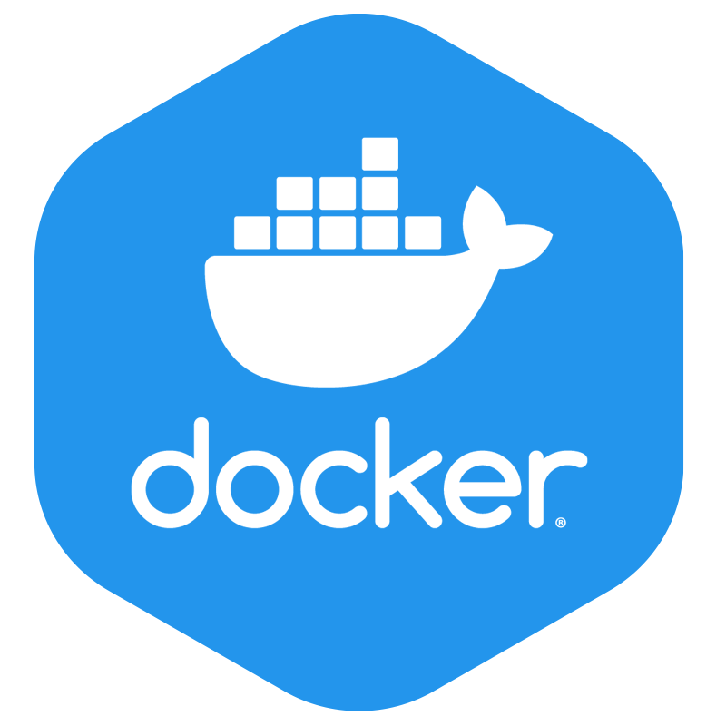
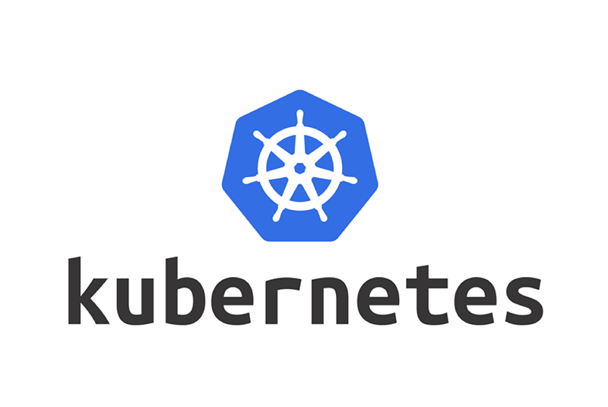

Code Container Container Orchestrator
➕
ML code container
Container orchestrator + load balancer

Slide 33
Deployment
Deployment refers to the process of making a software application or update available to end-users by installing and configuring it on a target environment like servers, desktops, or mobile devices.
The goal is to efficiently and reliably make the software ready for use, which can involve a combination of manual and automated processes to handle installation, configuration, and updates.

Slide 34
Deployment ML serving
Let’s say that the ML model requires 6 CPU cores and 8 GB RAM and we have total 3 users

Slide 35

Deployment ML Serving
Let’s say that the ML model requires 6 CPU cores and 8 GB RAM and we have total 3 users
Node-1
(6 CPU, 8 GB RAM)
Node-2
(6 CPU, 8 GB RAM)
Node-3
(6 CPU, 8 GB RAM)

Slide 36
Deployment ML Serving
Let’s say that the ML model requires 6 CPU cores and 8 GB RAM and we have total 3 users
Node-1
(6 CPU, 8 GB RAM)
Node-2
(6 CPU, 8 GB RAM)
Node-3
(6 CPU, 8 GB RAM)

Slide 37
Deployment
Let’s say that the ML model requires 6 CPU cores and 8 GB RAM and we have total 3 users
Node-1
(6 CPU, 8 GB RAM)
Node-2
(6 CPU, 8 GB RAM)
Node-3
(6 CPU, 8 GB RAM)

Slide 38
Deployment ML Serving
Node-1
(6 CPU, 8 GB RAM)
Node-2
(6 CPU, 8 GB RAM)
Node-3
(6 CPU, 8 GB RAM)

Slide 39
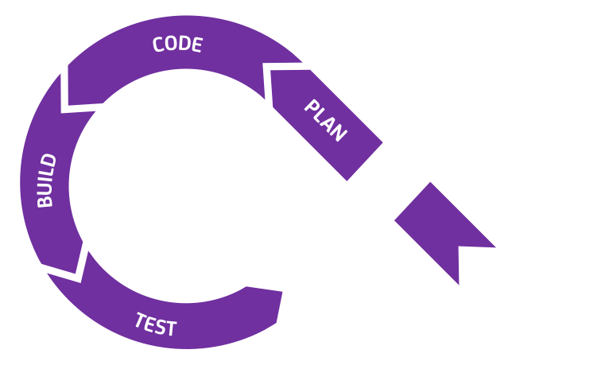
Translate to DevOps concepts
Planning for the development of work (scope definition)
Checkout the code version from a code hosting/collaboration tool (git)
Code quality checking
Running all the tests and check code coverage
Container building
Container scanning for security vulnerabilities
Container image saving with version tracking

Slide 40
Translate to DevOps concepts
Planning for the development of work (scope definition)
Checkout the code version from a code hosting/collaboration tool (git)
Code quality checking
Running all the tests and check code coverage
Container building
Container scanning for security vulnerabilities
Container image saving with version tracking
Continuous Integration (CI)

Slide 41
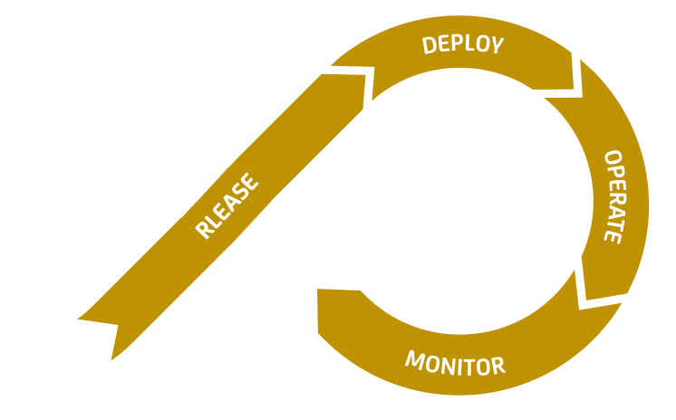
Translate to DevOps concepts
Release
Save the image container in container registry → publish image
Deploy
Combines published container image together with a set of user defined config parameters
Creates deployment unit
Actual deployment
Rollback on failure
Production run
Monitor the deployment

Slide 42
Translate to DevOps concepts
Release
Save the image container in container registry → publish image
Deploy
Combines published container image together with a set of user defined config parameters
Creates deployment unit
Actual deployment
Rollback on failure
Production run
Monitor the deployment
Continuous Delivery (CD)

Slide 43
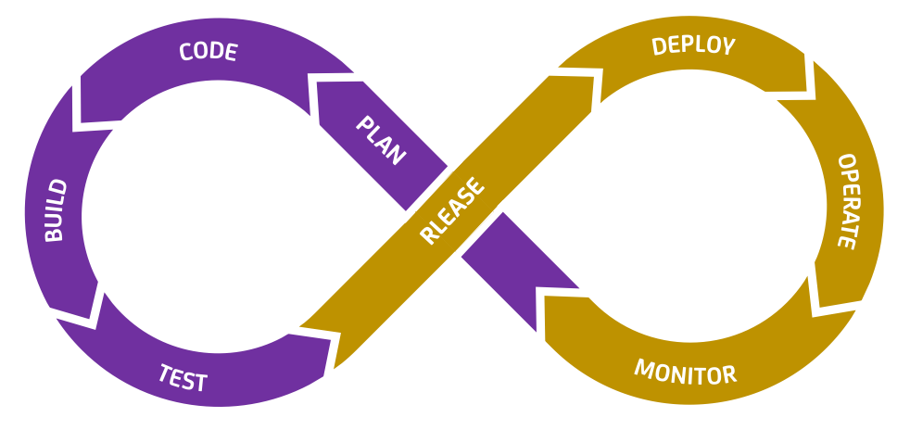
CI/CD
It's a DevOps practice that automates building, testing, and deploying code changes, enabling faster and more reliable software releases.

Slide 44

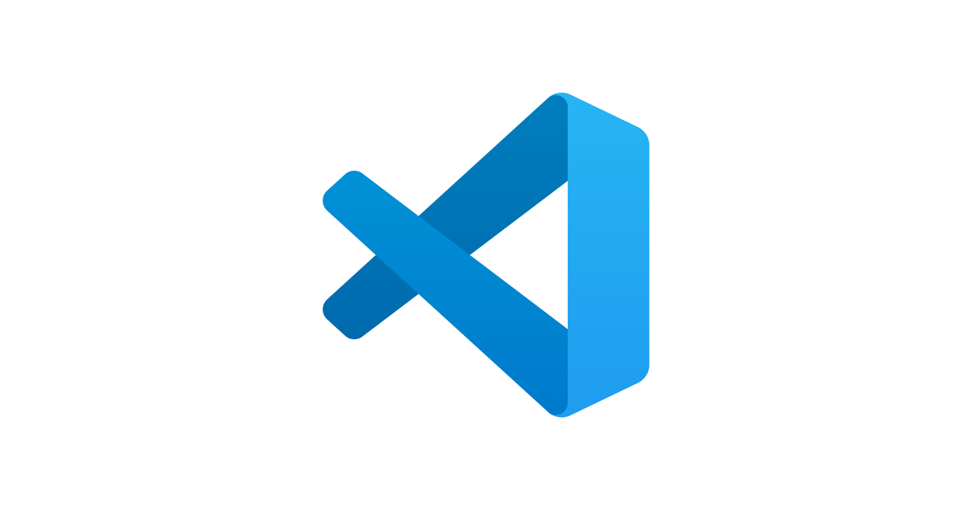
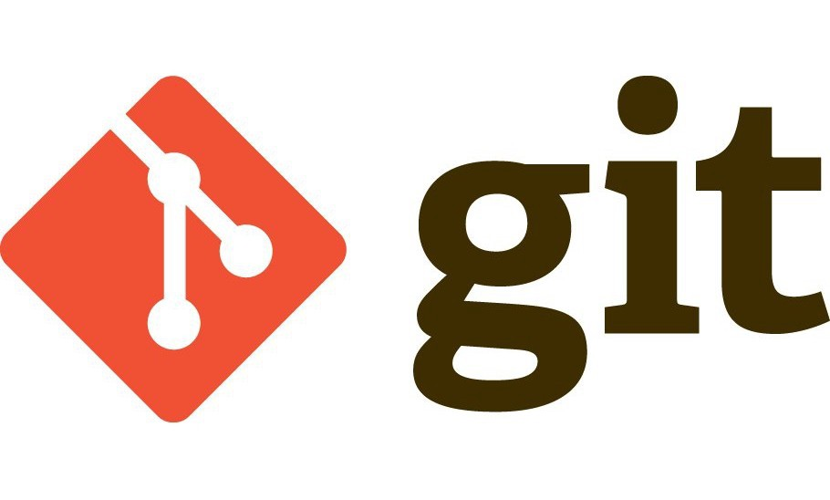
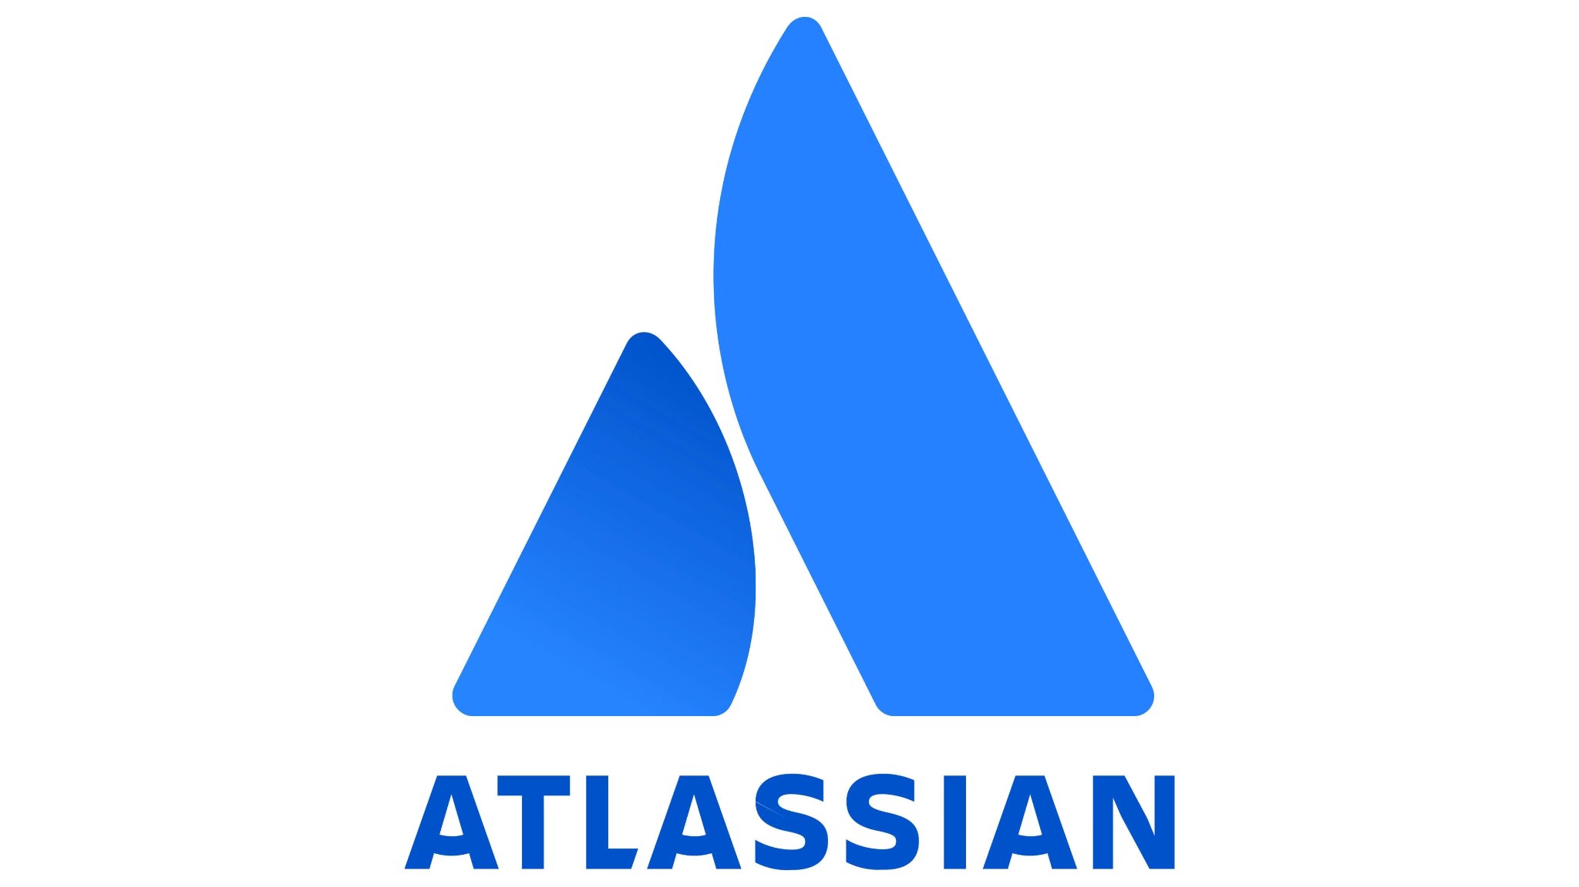

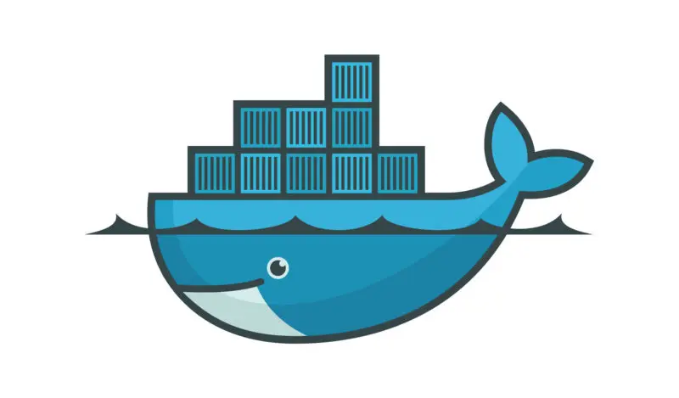



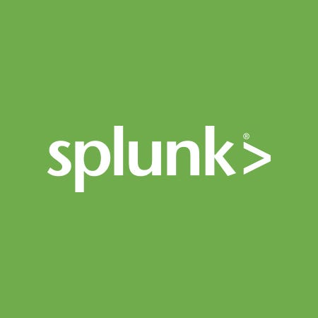
CI/CD - tools

Slide 45
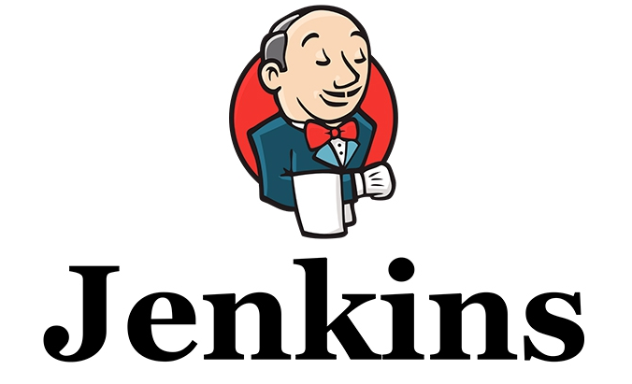

CI/CD - tools

Slide 46
Catch point: Model drift
𝑿
𝐲
Business use-case
Data (𝑿)
ML Model (𝑿 →𝐲)
Deployment
The data distribution in Production often varies from the data distribution used for the initial model training → Model drift
How to identify the model drift? → Human in the Loop
How to properly address this model drift? → DataML/DataOps

Slide 47
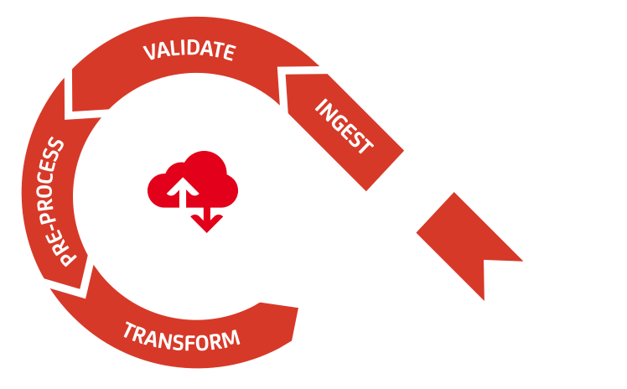
Data pipeline
Data ingestion with data versioning
Data validation pipeline
Data pre-processing
Data transformation into suitable data object to facilitate the ML model dev ste

Slide 48
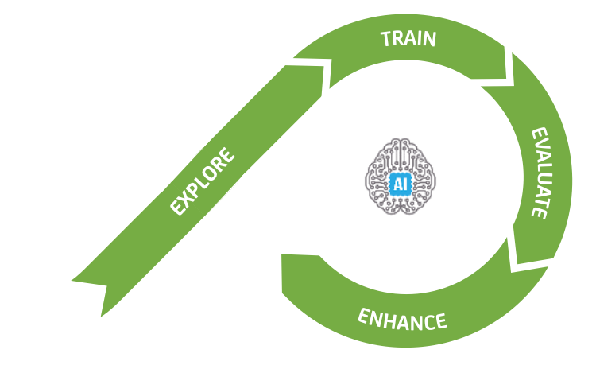
ML pipeline
Data exploration with feature analysis
ML algorithm selection and model training
ML model evaluation
Hyper-parameter tuning
Model monitoring for enhancement

Slide 49
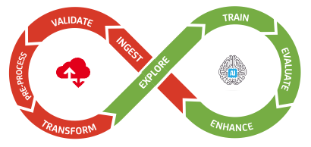
DataML = Data + ML
DataML is a set of practices that consolidates the Data and ML pipeline for a robust data management and ML model training process

Slide 50
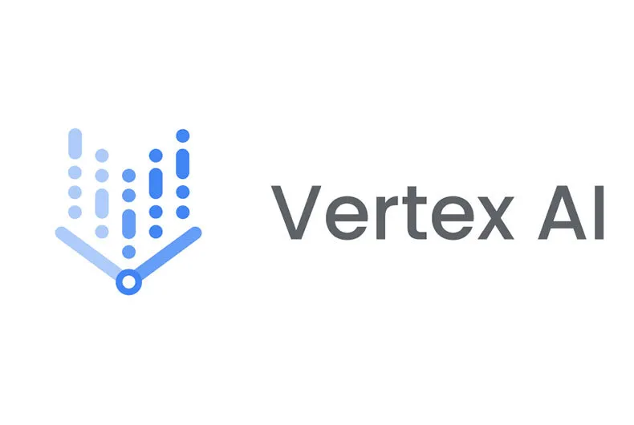





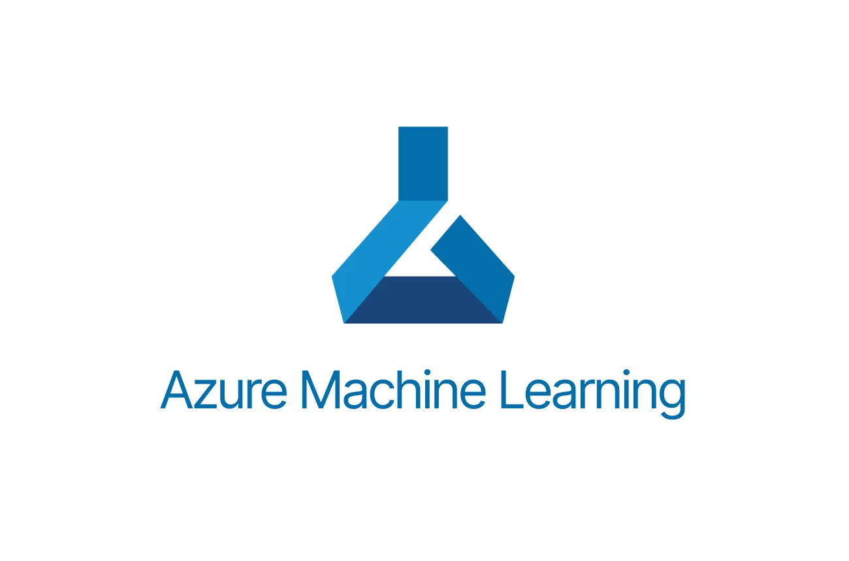
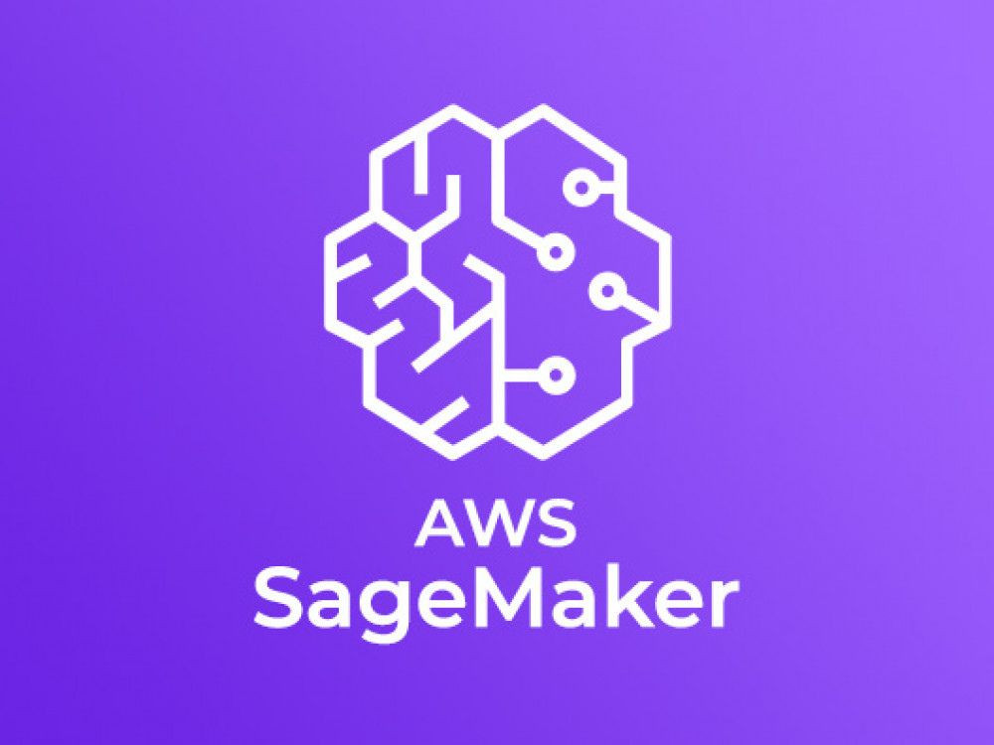
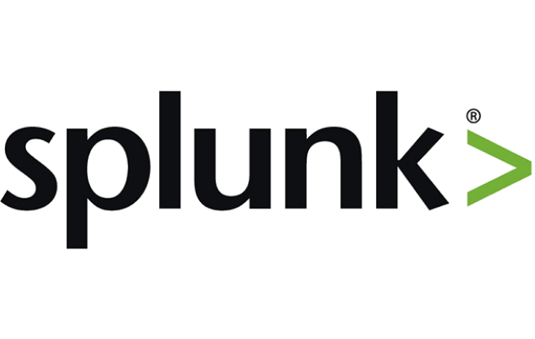
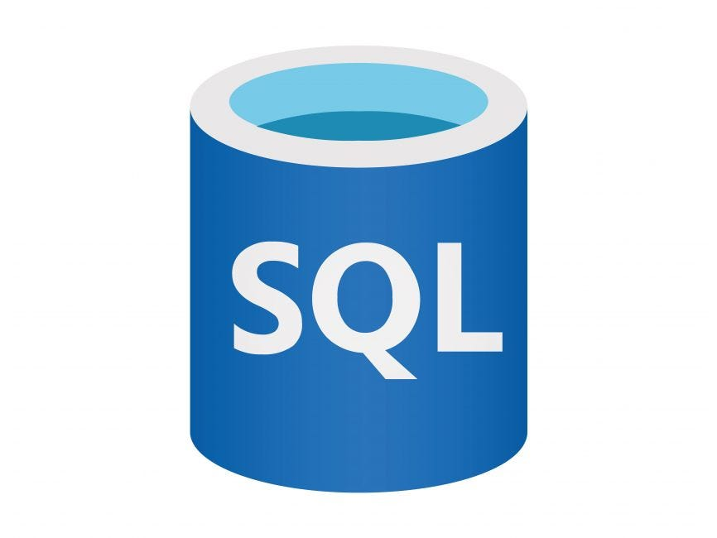
DataML - tools

Slide 51
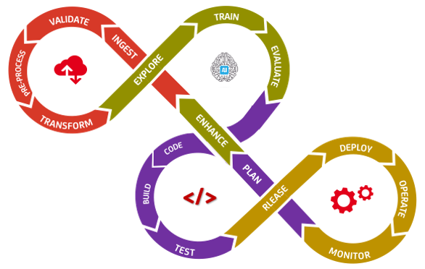
MLOps = DataML + DevOps
MLOps, or Machine Learning Operations, is a set of practices that automate and streamline the machine learning (ML) lifecycle, from development to deployment and maintenance. It ensures that the models are built, tested, and deployed in a reliable, scalable, and consistent way.

Slide 52
ML app lifecycle
Starts with a business use-case
Completely new application or,
Replacement of an existing application
Quick feasibility analysis
Full business requirements and estimations →Code development, Infrastructure, Security/Compliance, Run management etc
Consolidation of methodology → ML model building
Industrialization → S/W engineering part for the end-to-end application
Testing → Integration test/Stress test
Monitoring setup with Human in the Loop
User Acceptance Test (UAT)
Go-live
Post go-live support
Run management

Slide 53
ML app lifecycle: Infrastructure env
An infrastructure environment for software development is the combination of underlying resources like hardware, networking, and software that hosts and runs applications.
Usually we have the following five environments in ML applications
Dev → where development, debugging happens
Test → Integration test, stress test etc happens
Staging/UAT/Mute/QAT/Q0 → User Acceptance Test happens
Production/C0 → Real application environment
Disaster Recovery/DR → In case of failure in Production environment
Test environment is sometimes optional
UAT, Production and DR should be identical

Slide 54
Types of ML app
Completely new product with ML capabilities
Total replacement of existing product with ML models
Incremental replacement with ML models
Multiple ML models for the same use-case
Based on the types of ML application use-cases, different deployment strategies can be used

Slide 55
Deployment strategies in ML prod
Blue-Green deployment
Two identical production environments are maintained, one active ("blue") and one inactive ("green"). The new model is deployed to the green environment, and when ready, traffic is switched from blue to green.
Minimizing downtime and quickly rolling back by simply switching traffic back to the old environment.
Canary deployment
The new model is released to a small subset of users or traffic. The performance of the new model is monitored, and if it's stable, the rollout is gradually increased to the rest of the users.
Testing new models in a live environment with a limited blast radius, allowing for a safe gradual rollout.

Slide 56
Deployment strategies in ML prod
Rolling deployment
The new model is deployed incrementally, gradually replacing instances of the old model. Each new instance is brought up and the old one is taken down one by one or in small batches.
Updating services with minimal downtime by gradually phasing out the old version.
A/B testing
Two different versions of a model (A and B) are deployed to different user segments. A/B testing compares their performance on real-world data to see which one is better based on predefined metrics.
Comparing different models head-to-head to choose the superior one before a full rollout.

Slide 57
Deployment strategies in ML prod
Shadow deployment
A new model version runs in parallel with the existing one, receiving a copy of the production traffic. The new model's results are recorded for analysis but are not used for actual responses; the live system continues to serve users based on the old model.
Evaluating a new model's performance, accuracy, and behavior under real-world load without any risk to end-users.

Slide 58
Real ML production components
API gateway → To receive the requests from backend
Message broker → Fault tolerance
Orchestrator → Contains business logic
ML serving → RestAPI + ML model
Output preparation block
DB tables, Internal storages → To save app/data states
Logging and monitoring unit
Human in The Loop

Slide 59
Real MLOps production components
Data lake → For data and features store with versioning
ML model registry
Data processing code container
ML model training code container
ML model evaluation code container
MLOps pipeline framework
DB table, internal storage

Slide 60
Compliance in ML applications
Responsible AI → AI Act, AI ethics
Responsible AI is an approach to developing and deploying artificial intelligence from both an ethical and legal standpoint. The goal is to employ AI in a safe, trustworthy and ethical way.
The AI Act is the European Union's comprehensive law to regulate artificial intelligence (AI) systems, setting rules for their development and use to ensure they are safe, trustworthy, and aligned with EU fundamental rights and values
Transparency and Accountability are the two main pillars of the AI Act
MLOps helps organizations comply with the EU AI Act by providing a framework for auditable, transparent, and reproducible AI lifecycles, which includes version control, automated testing, and continuous monitoring

Slide 61
Demo: ML serving
Pre-trained ML model from Kaggle which classifies an image having either a cat or a dog into cat/dog category (link)
Wrap the model within RESTful API
Unittest
CI pipeline → Docker
CD pipeline →Local infrastructure
ML serving testing using python code and postman

Slide 62
Demo: MLOps
Setup MLOps tools
MLFlow together with minio and mysql
Run a ML model training code using Kaggle dataset (link) about property value using Random forest classifier
Model run tracking in MlFlow

Slide 63
Quick recap
Explained the concept of ML in prod
Highlighted major catchpoints
ML serving
Model drift
Blending with DevOps practice to obtain MLOps
ML life cycle
Types of deployment strategies
Compliance in ML production application
Demonstration of ML serving and MLOps in an approximated scope

Slide 64
Q&A
Thank you for your attention!

